Slide 1

Machine Learning Assignment: Heart Disease
NCSR-D
MSc in Artificial Intelligence
Eneri boniakou

Slide 2
Database Selection
The heart disease database was chosen*. The goal is to check the presence of heart disease in the patient.
Classification task: We will set y to 0 for absence and 1 for presence of a heart disease.
Features (x) | Value/Info
Age (age) | Age of patient
Sex (sex) | 1 or 2 [1=Male, 2=Female]
Chest Pain type (cp) | 1 through 4
Resting Blood Pressure (trestbps) | Real number
Cholesterol (chol) | Real number
Fasting Blood Sugar (fbs) | 1 or 2 (1= >120mg/dL, 2= <120mg/dL)
Resting ECG Results (restecg) | Normal, Bradycardia, Tachycardia (1, 2, 3)
Max Heart Rate Achieved (thalach) | Real Number
Exercise Induced Angina (exang) | 0 or 1 (0=absence, 1=angina occurred)
Oldpeak (oldpeak) | Real number
Slope of the Peak Exercise ST Segment (slope) | 1, 2, 3 (1=Upsloping, 2=Flat, 3=downsloping)
Number of Major Vessels Colored [by Fluoroscopy] (ca) | Integer Number
Thalassemia (thal) | 3, 6, 7 (3= Normal, 6=Fixed defect, 7=Reversible defect
* https://archive.ics.uci.edu/dataset/45/heart+disease

Slide 3
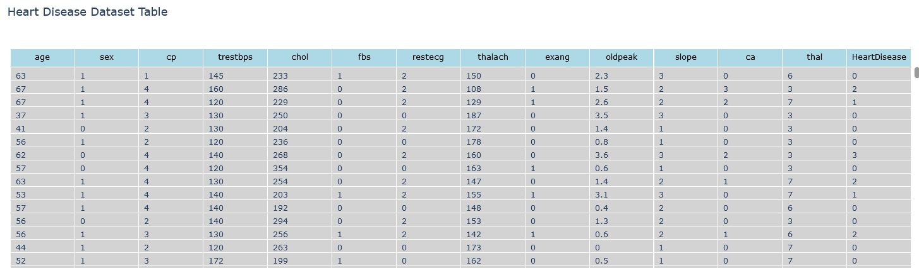
Data Exploration - Features
303 Instances.
13 Real Features (x).
1 Target Value (y).
If heart Disease >0, y=1 otherwise y = 0.

Slide 4
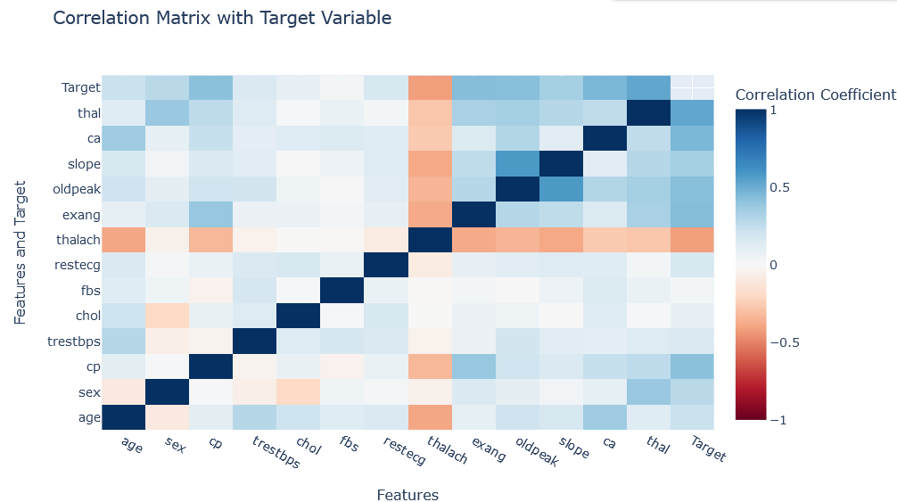
Data Exploration – Handle Missing/NaN Values – Correlations
Set missing x’s as the mean value of the feature.
Set the missing y’s as the mode of the target values (no missing values were found in y)
Calculate Pearson’s coefficient and set a threshold of 0.7; features with |r| > 0.7 will be left out
|r|<0.7 for every feature

Slide 5
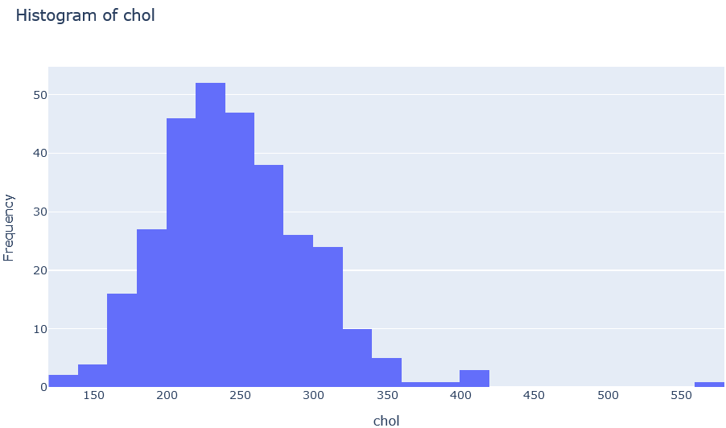
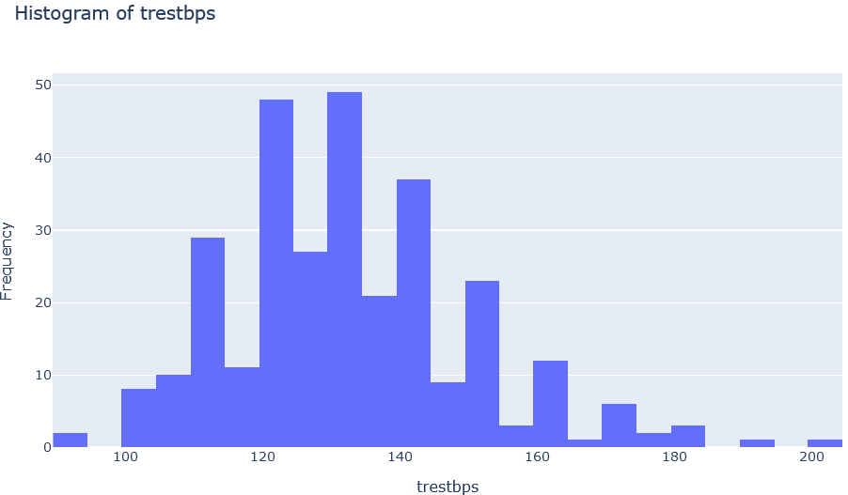

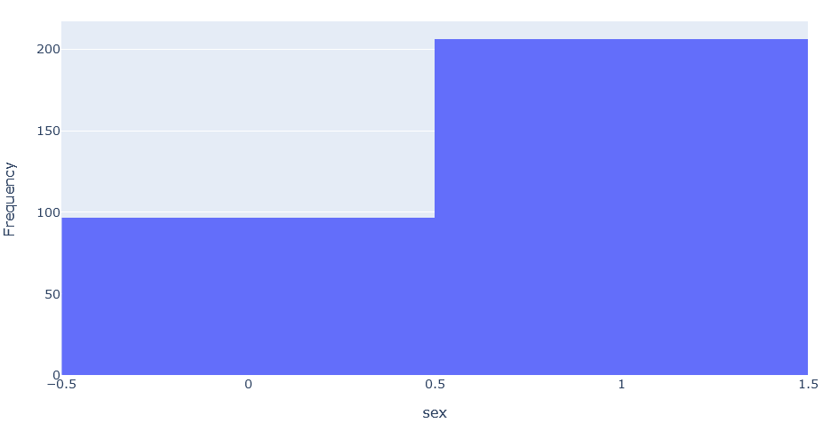
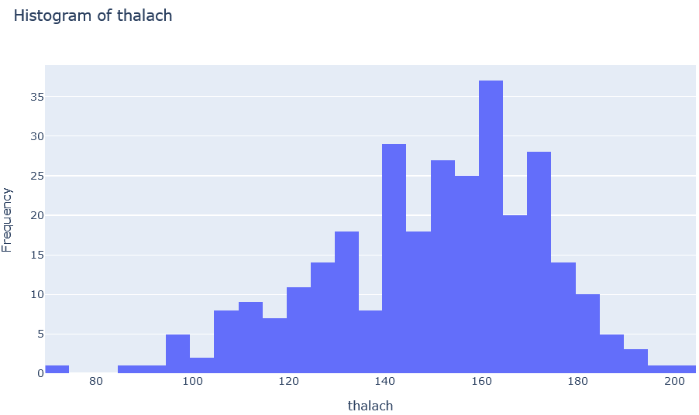
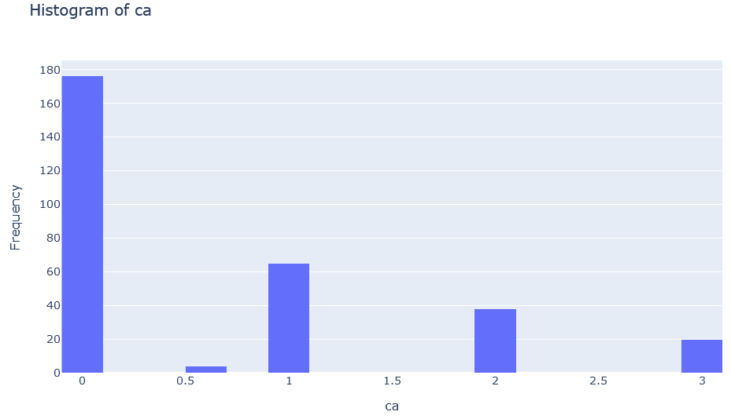
Data Exploration – Histograms Examples

Slide 6
Fit The Models – Data splitting and normalization
To perform the training of the models, the data will be splitted as 80% for training and 20% for testing randomly. (A seed is set so the data is splitted in the same manner every time the code is executed).
Before fitting, the data is scaled with z-normalization:
Models Used:
Logistic Regression
Support Vector Machine
Random Forest
K-Nearest Neighbors
Adaboost
Decision Tree

Slide 7
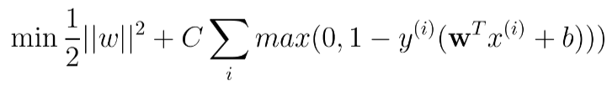
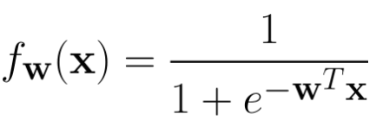
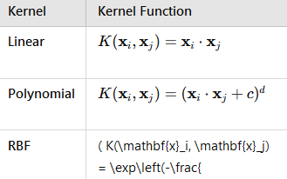

Fit The Models - Tuning
Before fitting, SVM needs to be optimized.
Hyperparameter C (regularization) and gamma need to be tuned
Kernel type should be chosen
Search Domain:
C: [0.1, 0.5, 1, 10]
gamma: [1, 0.1, 0.01, 0.001]
Kernel: [‘linear’, ‘rbf’, ‘poly’]
Note: Using a more dense grid will result in higher computational cost

Slide 8
Fit The Models – Cross Validation
For the Testing Repeated K-Fold was used in order to report the dev of the metrics
Metrics used:
Accuracy
Precision
Recall
F1-Score
AUC-ROC
Also speed of each model is reported for comparison.

Slide 9
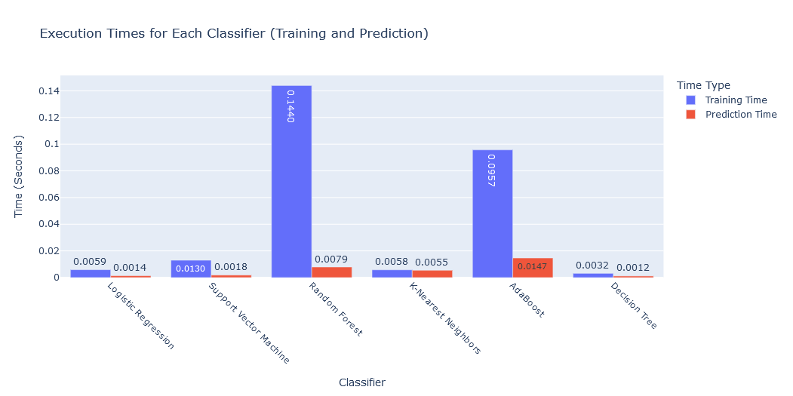
Speed
Slow: Random Forest
Adaboost
Fastest: Decision Tree

Slide 10
Speed
In theory…
In terms of training, Logistic Regression and decision trees are expected to be the fastest, followed by kNNs, SVMs and Random Forest. AdaBoost also is expected to be slow due to sequential learning.
In terms of testing, Logistic Regression generally is fast, followed by SVMs, Adaboost. Decision Trees and Random Forests can be slow depending on the depth. kNN can also be very slow since it computes the distance to every training sample.
Here…
Decision Tree was the fastest in both training and evaluation. Logistic Regression has also same speed in evaluation.
Random Forest with AdaBoost were the slowest; both in training and evaluation.

Slide 11
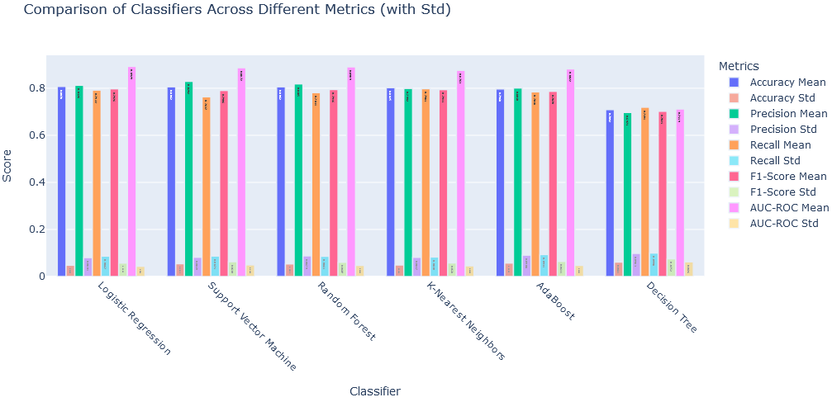
Metrics - overall

Slide 12
Metrics - numbers
 | Logistic Regression | SVM | Random Forest | kNN | AdaBoost | Decision Tree
Accuracy | 0.81 ± 0.05 | 0.81 ± 0.06 | 0.80 ± 0.05 | 0.80 ± 0.05 | 0.80 ± 0.06 | 0.71 ± 0.06
Precision | 0.81 ± 0.08 | 0.83 ± 0.08 | 0.81 ± 0.09 | 0.80 ± 0.08 | 0.80 ± 0.09 | 0.70 ± 0.10
Recall | 0.79 ± 0.09 | 0.76 ± 0.09 | 0.78 ± 0.08 | 0.80 ± 0.08 | 0.79 ± 0.09 | 0.71 ± 0.10
F1-Score | 0.80 ± 0.06 | 0.79 ± 0.06 | 0.79 ± 0.06 | 0.79 ± 0.06 | 0.79 ± 0.06 | 0.70 ± 0.07
AUC-ROC | 0.89 ± 0.04 | 0.89 ± 0.05 | 0.89 ± 0.04 | 0.88 ± 0.05 | 0.88 ± 0.05 | 0.71 ± 0.06
Without using Repeated K-Fold method and doing a simple train, the accuracy of the models were higher. But since the dataset is rather small, with repeated K-Fold the model is not biased due to a single split and the final estimation of performance is more stable.
All the models, except Decision Tree have quite similar metrics. Since we are talking about a medical diagnose, The recall should high. For example kNN misses 20% in detection of a disease with an uncertainty of ± 8% and the model’s performance, by AUC-ROC, yields an 88% probability of correctly distinguishing between presence and absence of disease with 5% uncertainty.

